Slide 1
Introduction to GLSL
(OpenGL Shading Language)
Advanced Graphics Programming

Slide 2
What is GLSL
GLSL: Graphics Library Shading Language
Syntax similar to C/C++
Language used to write shaders
Vertex, fragment, geometry, tessellation, compute
First available in OpenGL 2.0 (2004)
Alternatives
Nvidia Cg
Microsoft HLSL

Slide 3
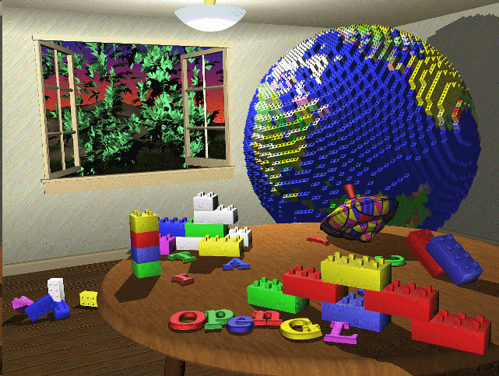
Without GLSL
OpenGL 25 years ago
No programmable pipeline
Graphics cards had a very limited set of operations
Vertex transform / fragment shading was hardcoded into GPUs

Slide 4
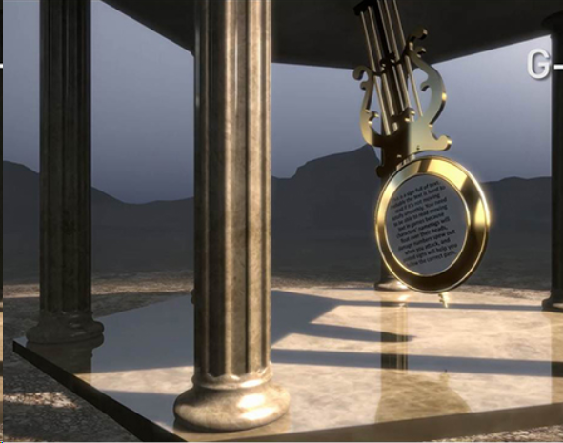
With GLSL
Modern OpenGL
More parts of the GPU are programmable (but not all)
Vertex processor
Fragment processor
The flexibility of programmable shaders allows the creation of astonishing visual effects

Slide 5
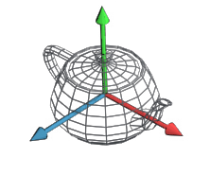
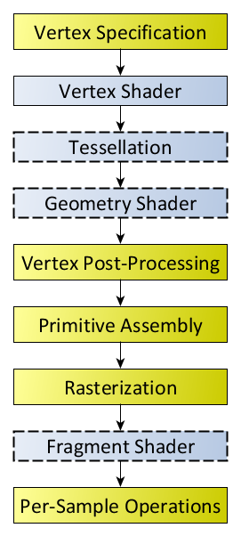

What is a shader program?
A small program that controls parts of the graphics pipeline
Consists of at least 2 separate parts
Vertex shader (controls vertex transforms)
Fragment shader (controls fragment shading)
Can also contain
Geometry shader (controls additional geometry generation)
Tessellation shader (controls primitive tessellation)

Slide 6
What is a shader program?
In this part of the subject, we are going to practice a little bit with fragment shaders

Slide 7
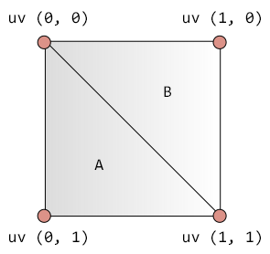
What is a shader program?
In this part of the subject, we are going to practice a little bit with fragment shaders
We will not worry about the model: just a quad (two triangles) will be rendered

Slide 8

What is a shader program?
In this part of the subject, we are going to practice a little bit with fragment shaders
We will not worry about the model: just a quad (two triangles) will be rendered
Shadertoy!

Slide 9
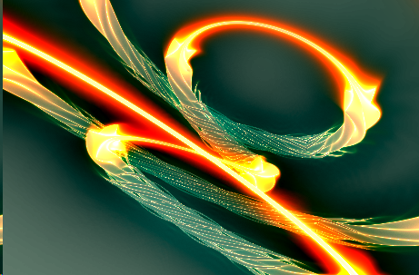

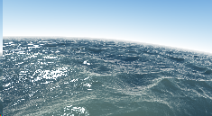
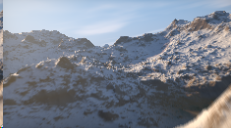
Take a look...
Even big procedural worlds can be created within the fragment processor.
GPU intensive
Difficult maths :_D
Some examples:
https://www.shadertoy.com/
https://www.shadertoy.com/results?query=landscape
https://www.shadertoy.com/results?query=reflections

Slide 10
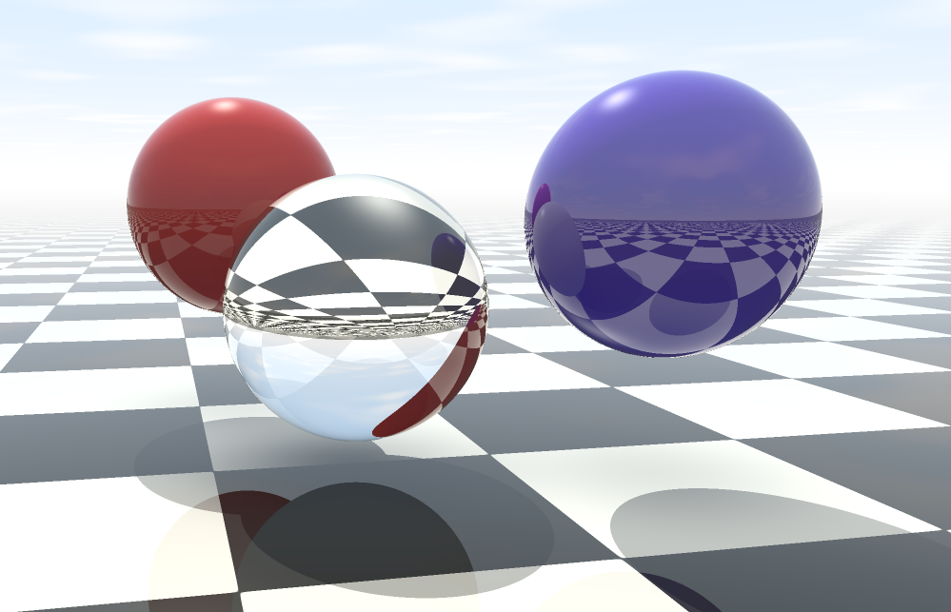
Our goal

Slide 11
GLSL basics

Slide 12
Data types
// booleans
bool
bvec2
bvec3
bvec4
// integers
int
ivec2
ivec3
ivec4
// floats
float
vec2
vec3
vec4
// matrices
mat2
mat3
mat4
// some variable definitions
bool b;
int i;
float v;
vec2 texCoord;
vec3 rgbColor;
vec4 position;
mat3 rotationMatrix;
mat4 transformMatrix;
// u. integers
uint
uvec2
uvec3
uvec4
// double
double
dvec2
dvec3
dvec4
// matrices (doubles)
dmat2
dmat3
dmat4

Slide 13
Data types
// GLSL type // OpenGL texture type
sampler1D GL_TEXTURE_1D
sampler2D GL_TEXTURE_2D
sampler3D GL_TEXTURE_3D
samplerCube GL_TEXTURE_CUBE_MAP
sampler2DRect GL_TEXTURE_RECTANGLE
sampler1DArray GL_TEXTURE_1D_ARRAY
sampler2DArray GL_TEXTURE_2D_ARRAY
samplerCubeArray GL_TEXTURE_CUBE_MAP_ARRAY
samplerBuffer GL_TEXTURE_BUFFER
sampler2DMS GL_TEXTURE_2D_MULTISAMPLE
sampler2DMSArray GL_TEXTURE_2D_MULTISAMPLE_ARRAY
These are sampler for standard color textures
Color values will have values from 0 to 1.
The prefixes i (isampler), and u (usampler) can be used for textures storing integers.
Used for uniform inputs.

Slide 14
Data types
Reference
For more information about GLSL data types, visit the wiki reference page at khronos.org:
https://www.khronos.org/opengl/wiki/Data_Type_(GLSL)

Slide 15
Uniform variables (any shader inputs)
CPU
GPU
Application
Configure uniforms
Primitives / vertex attributes (position, normal, tex coords…)
Vertex program
gl_Position & custom vertex outputs
Uniform variables
Rasterizer
Per-fragment interpolation of vertex outputs
Interpolated fragment inputs
Uniform variables are specified in a per-draw call basis
Fragment program
Framebuffer
Color, depth, ...

Slide 16
Uniform variables in Shadertoy
uniform vec3 iResolution;
uniform float iTime;
uniform vec4 iMouse;
// Many others...
Shadertoy documentation:
https://www.shadertoy.com/howto

Slide 17
Built-in functions
GLSL provides fairly big set of functions to develop shaders
Mathematics
GPU-accelerated
Efficient
Texture lookups

Slide 18
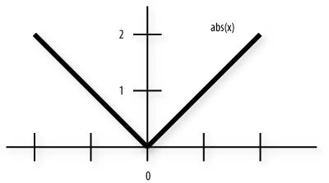
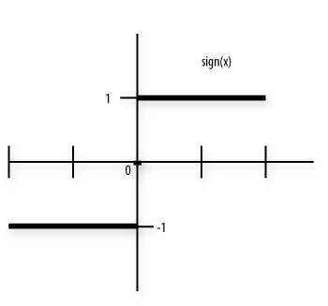
Built-in functions: Abs / Sign
// Returns x if x >= 0; otherwise, it returns -x.
float abs (float x)
vec2 abs (vec2 x)
vec3 abs (vec3 x)
vec4 abs (vec4 x)
// Returns 1.0 if x > 0, 0.0 if x = 0, or -1.0 if x < 0.
float sign (float x)
vec2 sign (vec2 x)
vec3 sign (vec3 x)
vec4 sign (vec4 x)

Slide 19
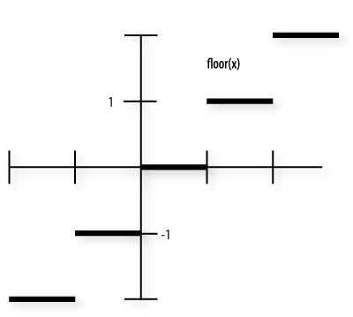
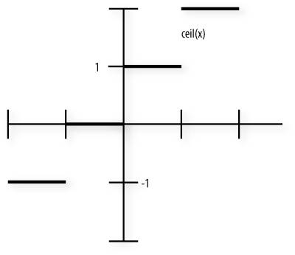
Built-in functions: Floor / Ceil
// Returns a value equal to the nearest integer that is
// less than or equal to x.
float floor (float x)
vec2 floor (vec2 x)
vec3 floor (vec3 x)
vec4 floor (vec4 x)
// Returns a value equal to the nearest integer that is
// greater than or equal to x.
float ceil (float x)
vec2 ceil (vec2 x)
vec3 ceil (vec3 x)
vec4 ceil (vec4 x)

Slide 20
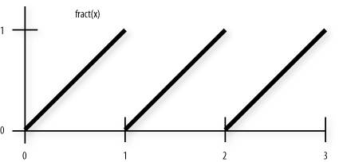
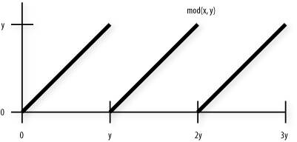
Built-in functions: Fract / mod
// Returns x - floor (x).
float fract (float x)
vec2 fract (vec2 x)
vec3 fract (vec3 x)
vec4 fract (vec4 x)
// Modulus. Returns x - y * floor (x/y) for each
// component in x using the floating-point value y.
float mod (float x, float y)
vec2 mod (vec2 x, float y)
vec3 mod (vec3 x, float y)
vec4 mod (vec4 x, float y)
// Modulus. Returns x - y * floor (x/y) for each
// component in x using the corresponding component of y.
vec2 mod (vec2 x, vec2 y)
vec3 mod (vec3 x, vec3 y)
vec4 mod (vec4 x, vec4 y)

Slide 21
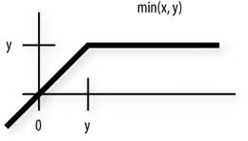
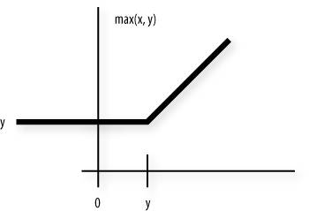
Built-in functions: Min / Max
// Returns minimum of each component of x compared with the floating-point value y.
vec2 min (vec2 x, float y)
vec3 min (vec3 x, float y)
vec4 min (vec4 x, float y)
// Returns y if x < y; otherwise, it returns x.
float max (float x, float y)
vec2 max (vec2 x, vec2 y)
vec3 max (vec3 x, vec3 y)
vec4 max (vec4 x, vec4 y)
// Returns maximum of each component of x compared
// with the floating-point value y.
vec2 max (vec2 x, float y)
vec3 max (vec3 x, float y)
vec4 max (vec4 x, float y) // and more...

Slide 22
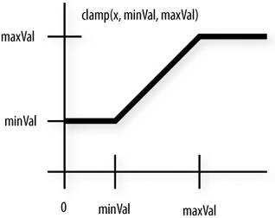
Built-in functions: Clamp
// Returns min (max (x, minVal), maxVal) for each
// component in x using the floating-point values minVal
// and maxVal. Results are undefined if minVal > maxVal.
float clamp (float x, float minVal, float maxVal)
vec2 clamp (vec2 x, float minVal, float maxVal)
vec3 clamp (vec3 x, float minVal, float maxVal)
vec4 clamp (vec4 x, float minVal, float maxVal)
// Returns the component-wise result of min (max (x,
// minVal), maxVal). Results are undefined if minVal >
// maxVal.
vec2 clamp (vec2 x, vec2 minVal, vec2 maxVal)
vec3 clamp (vec3 x, vec3 minVal, vec3 maxVal)
vec4 clamp (vec4 x, vec4 minVal, vec4 maxVal)

Slide 23
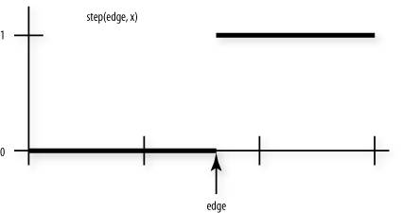
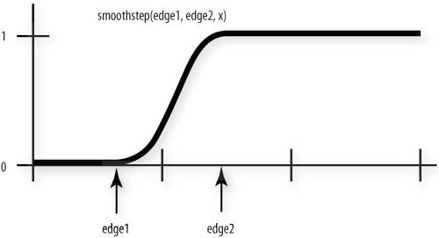
Built-in functions: Step / Smoothstep
// Returns 0 if x < edge; otherwise, it returns 1.0.
float step (float edge, float x)
vec2 step (vec2 edge, vec2 x)
vec3 step (vec3 edge, vec3 x)
vec4 step (vec4 edge, vec4 x)
// Returns 0 if x <= edge0 and 1.0 if x >= edge1 and
// performs smooth Hermite interpolation between 0 and 1
// when edge0 < x < edge1. Results are undefined if
// edge0 >= edge1.
float smoothstep (float edge0, float edge1, float x)
vec2 smoothstep (vec2 edge0, vec2 edge1, vec2 x)
vec3 smoothstep (vec3 edge0, vec3 edge1, vec3 x)
vec4 smoothstep (vec4 edge0, vec4 edge1, vec4 x)

Slide 24
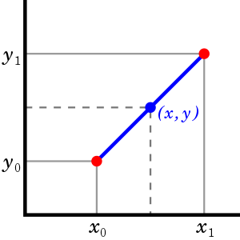
Built-in functions: Mix
// Returns x * (1.0 - a) + y * a, i.e., the linear blend
// of x and y using the floating-point value a. The value
// for a is not restricted to the range [0,1].
float mix (float x, float y, float a)
vec2 mix (vec2 x, vec2 y, float a)
vec3 mix (vec3 x, vec3 y, float a)
vec4 mix (vec4 x, vec4 y, float a)
// Returns the component-wise result of x * (1.0 - a) + y
// * a, i.e., the linear blend of vectors x and y using
// the vector a. The value for a is not restricted to the
// range [0,1].
vec2 mix (vec2 x, vec2 y, vec2 a)
vec3 mix (vec3 x, vec3 y, vec3 a)
vec4 mix (vec4 x, vec4 y, vec4 a)

Slide 25
Built-in functions: Many others
Trigonometry
Sin, cos, tan, asin, acos, atan… // In radians!
Exponential
Pow, exp2, log2, sqrt, inversesqrt...
Geometric
Length, distance, dot, cross, normalize, reflect, refract…
Texture lookup
Before: texture1D, texture2D, texture3D, textureCube
Now: texture (overloads for all texture types)
Texture info
textureSize

Slide 26
OpenGL Shading Language
Reference
For more information about GLSL, visit the wiki reference page at khronos.org:
https://www.khronos.org/opengl/wiki/OpenGL_Shading_Language

